Slide 1
CAMPUS PLACEMENT PREDICTION

Slide 2

TEAM PRESENTATION
Shubham Solanki B211074
Vishal Jhadhav
B211026
Ekansh Khandekar B211035
Sanyami Naik B211050
Guide:
Prof – Mr. Amol Bhosale
B.E. (Computer Engineering)
ZCOER, PUNE.

Slide 3
CONTENTS
Problem Statement
Motivation & Objective
Literature Survey
Technology used
Tools & installation process
Module specification
Proposed Result
Conclusion
Refrences

Slide 4
PROBLEM STATMENT
Pandemic has caused a drop in the number of students getting placed. It is difficult to apply or attend Interviews to get a job or an internship.
How are companies supposed to approach the students in this new era? There is a need for an efficient and a transparent system, where the students can apply for on-campus placements without any hesitation.
Zeal College Of Engineering & Research Pune™

Slide 5
MOTIVATION
According to statistics 1.6 million students graduate as engineers every year and the demand for skilled and qualified students is rising day by day.
Placements are the biggest opportunities in the life of a student and they need to be fully prepared while attempting it.
Placement Predictor system helps in predicting whether a student will get placed or not. This system can also be helpful for identifying the areas where the student needs to work on, for the placements.

Slide 6
OBJECTIVES
Explanatory Data Analysis
Prediction of whether the student gets placed or not
A full proof transparent system for on-campus placements
Create a User friendly and an interactive GUI

Slide 7
LITERATURE SURVEY
Publisher | Author | Year | Name of the paper
SPRINGER | Bharat Udawat , Advait Kale, Divit Sinha , Hardik Sharma | 2021 | Placement Prediction System
IEEE | Nikhil Kumar Ajay Singh E.Rajesh | 2020 | Campus Placement Predictive Analysis Using Machine Learning Techniques.
Zeal College Of Engineering & Research Pune™

Slide 8







TECHNOLOGY
USED
Zeal College Of Engineering & Research Pune™

Slide 9
TOOLS & INSTALLATION PROCESS
Visual Studio Code - Code Editing. Redefined
Click the option Download .
Select a folder by clicking Browse
Select the required options .
Select Install .
Click Finish to exit Setup.
'Notepad++
Go to the following website: - http://notepad-plus-plus.org/download/v6.6.1.html
Click on 'Notepad++ Installer'
Click 'Install'
Click Finish to exit Setup.
Mongo DB
Download the MongoDB MSI Installer Package
Install MongoDB with the Installation Wizard
Create the Data Folders to Store our Databases
Click Finish to exit Setup.
Node.js
Download Installer for Windows
Run the installation
Set up the path
Start the installation
Click Finish to exit Setup

Slide 10
MODULE SPECIFIACTION
GUEST
Response
Request
STUDENT
Request
Response
RECRUITER
Placement
Prediction
Response
Request
Request
Response
Response
Request
ADMIN
COORDINATOR
Zeal College Of Engineering & Research Pune

Slide 11
PROPOSED SYSTEM
STUDENT
Login /Signup
Prediction
Apply for Job
Zeal College Of Engineering & Research Pune

Slide 12
ADMIN
PROPOSED
SYSTEM
Generate Data
Train Data
Dump Data
Select Coordinator
Add Company
Schedule Event
Add Dept
Add Course
Zeal College Of Engineering & Research Pune

Slide 13
RECRUTIER
PROPOSED
SYSTEM
Post Job
Schedule Interview
Select Student
Zeal College Of Engineering & Research Pune

Slide 14
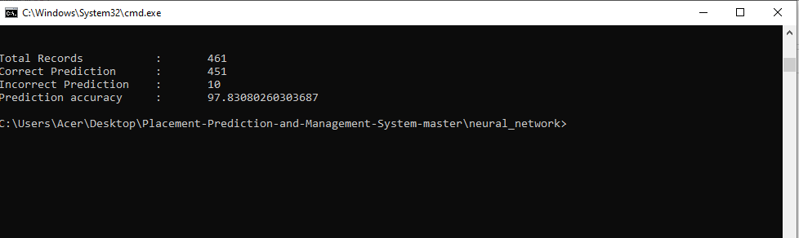
RESULT
Accuracy prediction

Slide 15
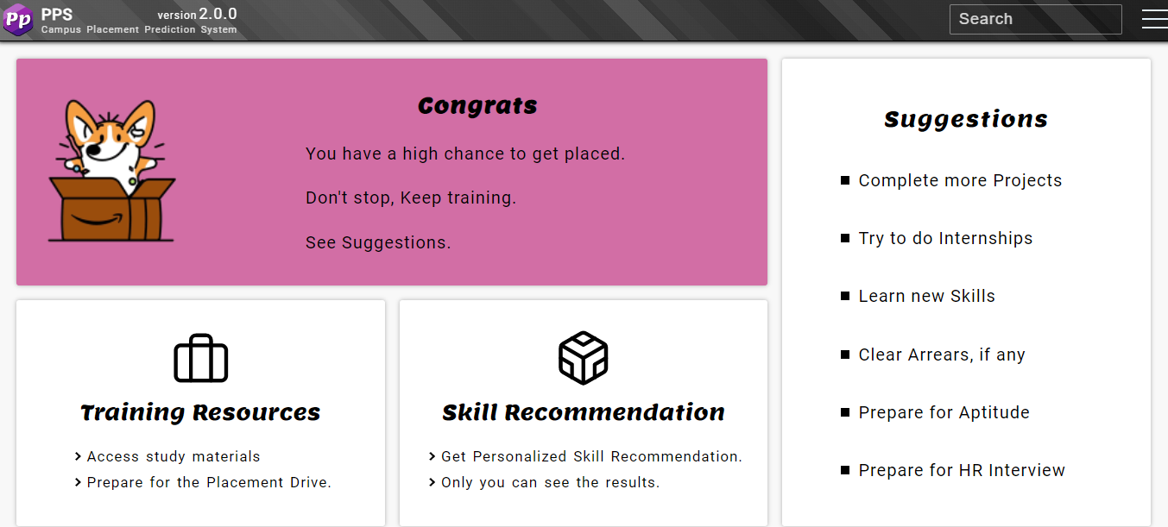
Prediction (Placed)

Slide 16
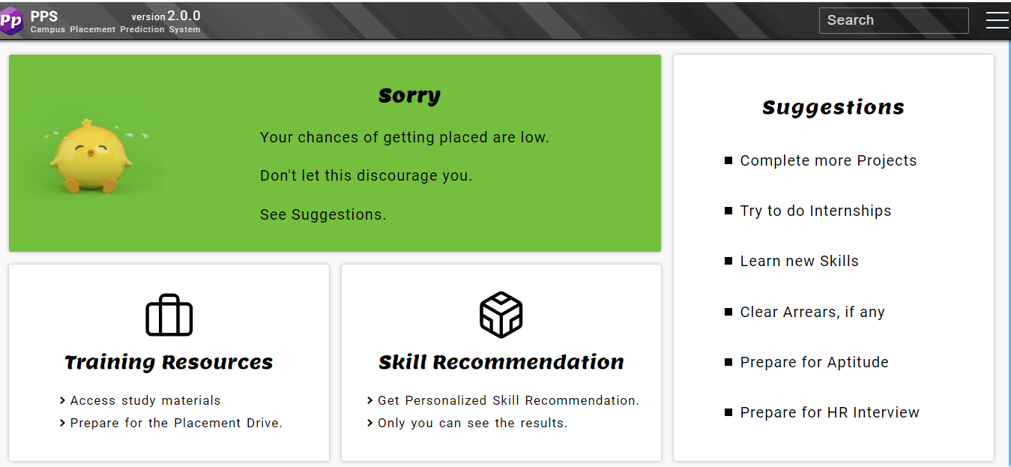
Prediction (Unplaced)

Slide 17
FUTURE SCOPE
Notification feature
Using real-time data of concerned colleges
Add QR code
Zeal College Of Engineering & Research Pune

Slide 18
CONCLUSION
Hence, we solved almost all the issues faced by coordinators and students and removed the communication barrier between the recruiters and the students. The proposed system will make the student overcome his skills and prepare him for future placements beforehand.
Zeal College Of Engineering & Research Pune

Slide 19
REFERENCES
[1] Prediction of Engineering Students’ Academic
Performance Using Artificial Neural Network and
Linear Regression: A Comparison; IEEE 5th
Conference on Engineering Education ICEED,
2013
[2] Placement Chance Prediction: Clustering and
Classification Approach; Artificial Intelligence and
Evolutionary Computations in Engineering
Systems, 2016
[3] Data Mining Approach For Predicting Student
and Institution's Placement Percentage;
International Conference on Computational
Systems and Information Systems for Sustainable
Solutions, 2016
[4] Chirag Patel; Identification of essential
parameters for postgraduate students’ job
placement in computer applications in India;
Bharati Vidyapeeth’s Institute of Computer
Applications and Management, 2018
Zeal College Of Engineering & Research Pune

Slide 20
THANK YOU!
Zeal College Of Engineering & Research Pune

Slide 21
ROADMAP
Blue is the colour of the clear sky and the deep sea
Red is the colour of danger and courage
Black is the color of ebony and of outer space
1
3
5
2
4
6
Yellow is the color of gold, butter and ripe lemons
White is the color of milk and fresh snow
Blue is the colour of the clear sky and the deep sea
Zeal College Of Engineering & Research Pune

Slide 22
Client Tier
FRONTEND
HTML/CSS/
JAVASCRIPT
CHROME
BROWSER
DESKTOP
IMPLIMENTATION
HTTP REQUEST
HTML PAGE
HTML PAGE
Business Logic Tier
CONNECTIVITY
NODEJS
EXPRESSJS
APPLICATION SERVER
REQUEST DATA
MONGODB DATA
Database Tier
BACKEND
MONGODB
DATABASE SERVER
Architecture Diagram

Slide 23
OUR PROCESS IS EASY
first
second
last
Zeal College Of Engineering & Research Pune

